Slide 1
FEB 11, 2025 I HICC Hyderabad

Slide 2
Lamp Lighting Invocation Ceremony

Slide 3
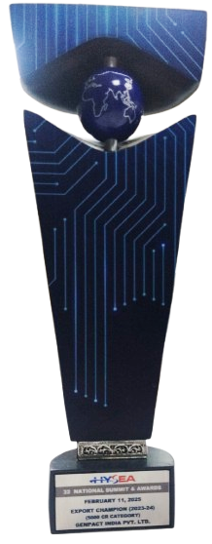
Evening
Annual Awards

Slide 4
Lamp Lighting, Invocation Ceremony

Slide 5
Welcome Address
Prashant Nandella
President, HYSEA

Slide 6
Address by
Kavitha C
Director, STPI-H

Slide 7
Address by Guest of Honour
Shri Jayesh Ranjan IAS
Special Chief Secretary
ITE&C Dept., Govt. of Telangana

Slide 8
Address by
Hon’ble Minister, IT & Industry, Telangana
Shri Sridhar Babu Duddilla
Hon’ble IT Minister of Telangana

Slide 9
Unveiling HYSEA Scale@Hyderabad:
Global Technology Destination Report - HYSEA, KPMG and AON, CBRE

Slide 10
Introduction of Lifetime Achievement Awardees
Ramakrishna Lingireddy
General Secretary, HYSEA

Slide 11
Lifetime Achievement
Award Presented to
Padma Shri Dr. Gullapalli Nageswara Rao
Founder, LVPEI
For his remarkable legacy of advancing innovation and technology in the service of humanity

Slide 12
Lifetime Achievement
Award Presented to
Padmashri Prof. Ashok Jhunjhunwala
IIT Madras
For his Pioneering and unparalleled contributions to society bringing in the convergence of research, industry and innovation in the convergence of Research, Industry & Innovation in Academia.

Slide 13
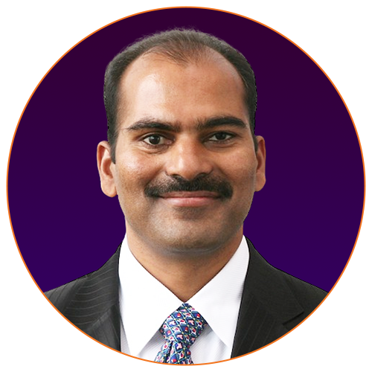
Introduction of Export Awards
Flt Lt Bipin Pendyala
Vice President, HYSEA & GM, Appen AI

Slide 14
Export Awards Presentation
Recognize and encourage IT Companies for Export, Growth and Workforce Leadership
Create a "Qualified Benchmark" for Industry Peers to emulate
Jury for FY24 consisted of ﻿
C. Kavitha, Director STPl, Hyderabad
﻿L. Suresh, CEO, Identis
Bipin Chandra Pendyala, Vice President, HYSEA
﻿Ramakrishna Lingireddy, General Secretary, HYSEA
﻿Export Data is obtained from SEZ and STPI

Slide 15
HYSEA-STPI EXPORT AWARDS 2023-24
EXPORT CHAMPION (2023-24)
INFOSYS LTD.

Slide 16
HYSEA-STPI EXPORT AWARDS 2023-24
EXPORT CHAMPION (2023-24)
TATA CONSULTANCY SERVICES LTD.

Slide 17
HYSEA-STPI EXPORT AWARDS 2023-24
EXCELLENCE IN GROWTH & WORKFORCE GROWTH LEADER (2023-24)
COGNIZANT TECHNOLOGY SOLUTIONS INDIA PVT. LTD.

Slide 18
HYSEA-STPI EXPORT AWARDS 2023-24
EXPORT CHAMPION (2023-24)
(GCC CATEGORY)
MICROSOFT INDIA R&D PVT. LTD.

Slide 19
HYSEA-STPI EXPORT AWARDS 2023-24
EXPORT CHAMPION (2023-24)
(GCC CATEGORY)
SALESFORCE.COM INDIA PVT. LTD.

Slide 20
HYSEA-STPI EXPORT AWARDS 2023-24
EXPORT CHAMPION (2023-24)
(5000 CR CATEGORY)
GENPACT INDIA PVT. LTD.

Slide 21
HYSEA-STPI EXPORT AWARDS 2023-24
EXPORT CHAMPION (2023-24)
(5000 CR CATEGORY)
DELOITTE SUPPORT SERVICES PVT. LTD.

Slide 22
HYSEA-STPI EXPORT AWARDS 2023-24
EXCELLENCE IN GROWTH (2023-24)
(5000 CR CATEGORY)
KYNDRYL SOLUTIONS PVT. LTD.

Slide 23
HYSEA-STPI EXPORT AWARDS 2023-24
EXPORT CHAMPION (2023-24)
(500 CR CATEGORY)
LSI INDIA R&D PVT. LTD.

Slide 24
HYSEA-STPI EXPORT AWARDS 2023-24
WORKFORCE GROWTH LEADER (2023-24)
(500 CR CATEGORY)
TELSTRA GLOBAL BUSINESS SERVICES

Slide 25
HYSEA-STPI EXPORT AWARDS 2023-24
RISING STAR (2023-24)
(TIER 2/3 CITIES CATEGORY)
ECLAT HEALTH SOLUTIONS (INDIA) PVT.LTD.

Slide 26
Introduction to Product Awards by
Raj Samala
Founder, Pushpak.AI

Slide 27
Product Awards Presentation
3-month process | 10-member planning team | 70-member jury
236 Nominations received, Evaluations in 2 rounds after initial screening
of nominations
In the first round, Jury of leading entrepreneurs, Product, Technical & Business leaders, Venture Capitalists, and academicians evaluated the products.The second round was the pitching round at IIIT-H, after which 53 Finalists were chosen for Showcase today. Top 10 Starts-up and top 3 Tech/Product Innovation will be Awarded today.

Slide 28
HYSEA 10X PRODUCT AWARDS - WINNER
EARLY-STAGE START-UP
Product Name: Hypervise.ai
Company Name: Eternal Robotics Pvt Ltd

Slide 29
HYSEA 10X PRODUCT AWARDS - WINNER
EARLY-STAGE START-UP
Product Name :LOW ENERGY NUCLEAR REACTORS
Company Name: Hylenr Technologies Pvt Ltd

Slide 30
HYSEA 10X PRODUCT AWARDS - WINNER
EARLY-STAGE START-UP
Company Name: AMRx®
Product Name: SCIINV Biosciences Pvt Ltd

Slide 31
HYSEA 10X PRODUCT AWARDS - WINNER
EARLY-STAGE START-UP
Product Name: Catalyst OT Platform for Solar Farms
Company Name: Xeeed IO Pvt Ltd

Slide 32
HYSEA 10X PRODUCT AWARDS - WINNER
EARLY-STAGE START-UP
Product Name: Embryo Quality Assessment
Company Name: Aispry Tutor Private Ltd

Slide 33
HYSEA 10X PRODUCT AWARDS - WINNER
EARLY-STAGE START-UP
Product Name: Starbuzz.ai
Company Name: Krisattva Private Limited

Slide 34
HYSEA 10X PRODUCT AWARDS - WINNER
EARLY-STAGE START-UP
Product Name: Avika Mind Health
Company Name: Ropana Digital Pvt Ltd (dba avika)

Slide 35
HYSEA 10X PRODUCT AWARDS - WINNER
EARLY-STAGE START-UP
Product Name: Cliniv
Company Name: Cliniv Health Tech

Slide 36
HYSEA 10X PRODUCT AWARDS - WINNER
EARLY-STAGE START-UP
Product Name: Rava AI
Company Name: Rava AI

Slide 37
HYSEA 10X PRODUCT AWARDS - WINNER
EARLY-STAGE START-UP
Product Name: NAVINAUT
Company Name: ALIEN INNOVATIONS

Slide 38
HYSEA 10X PRODUCT AWARDS
Special Jury Mention
EARLY-STAGE START-UP
Product Name: ToW- Tinker on Wheels
Company Name: Young Tinker Foundation

Slide 39
HYSEA TECH-PRODUCT/INNOVATION AWARDS - WINNER
ESTABLISHED CATEGORY
Product Name: Centific Frontier AI Data Foundary
Company Name: Centific Global Technologies India
Pvt Ltd

Slide 40
HYSEA TECH-PRODUCT/INNOVATION AWARDS - WINNER
ESTABLISHED CATEGORY
Product Name: Pega GenAI Blueprint
Company Name: Pegasystems Worldwide India Pvt. Ltd

Slide 41
HYSEA TECH-PRODUCT/INNOVATION AWARDS - WINNER
ESTABLISHED CATEGORY
Product Name: DBS Digibot: The Next-Gen Chatbot
Company Name: DBS Tech India

Slide 42
Vote of Thanks by
Ramakrishna Lingireddy
General Secretary, HYSEA

